Slide 1

Vishwa General Store Report 2023
Author: Mr. Jay Chavan

Slide 2

Vishwa store wants to create an annual sales report for 2023. So that, vishwa can understand their customers and grow more sales in 2024.
Objectives
Author: Mr. Jay Chavan

Slide 3
sTEPS:
IMPORTING DATA SET
DATA CLEANING
DATAPROCESSING
DATA ANALYSIS
DASHBOARD CREATION

Slide 4
Sample Questions
Compare the sales and orders using single chart
Which month got the highest sales and orders?
Who purchased more- men or women in 2022?
What are different order status in 2022?
List top 10 states contributing to the sales?
Relation between age and gender based on number of orders
Which channel is contributing to maximum sales?
Highest selling category?

Slide 5
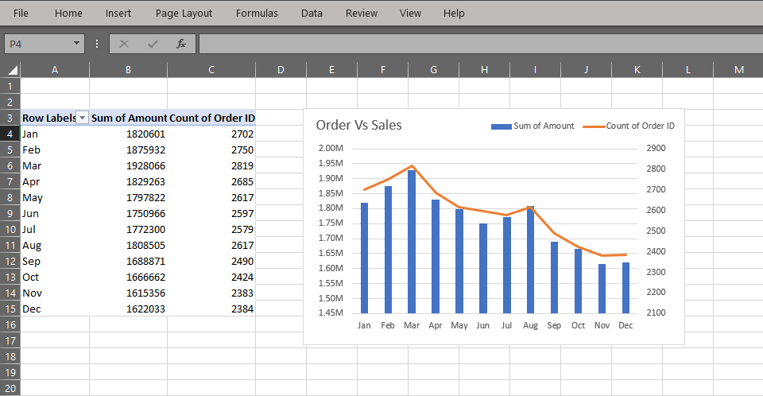
Order Vs Sales

Slide 6
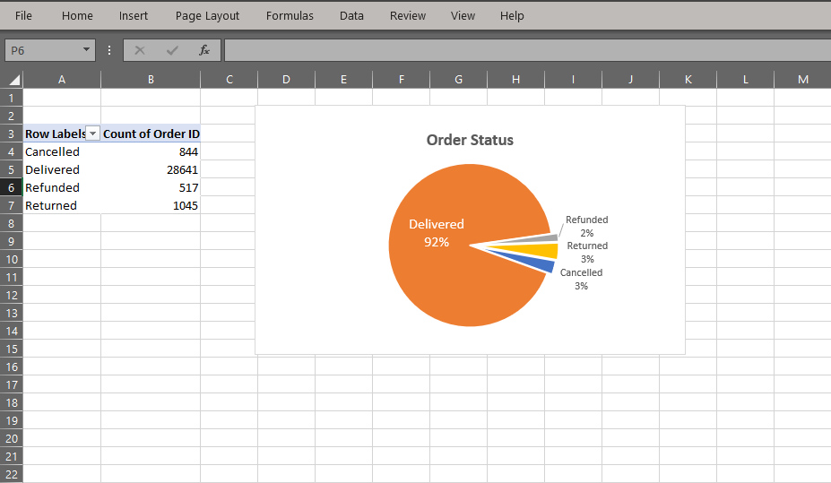
Order Status

Slide 7
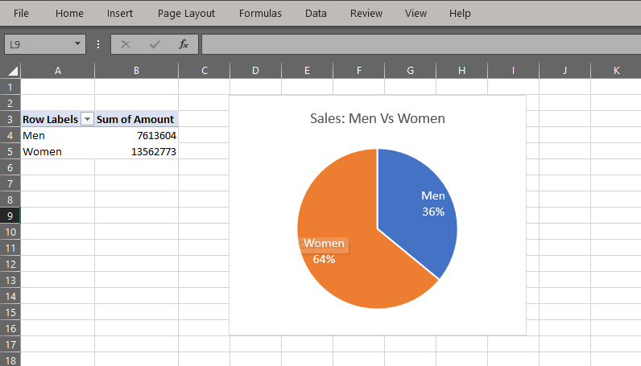
Sales: Men Vs Women

Slide 8
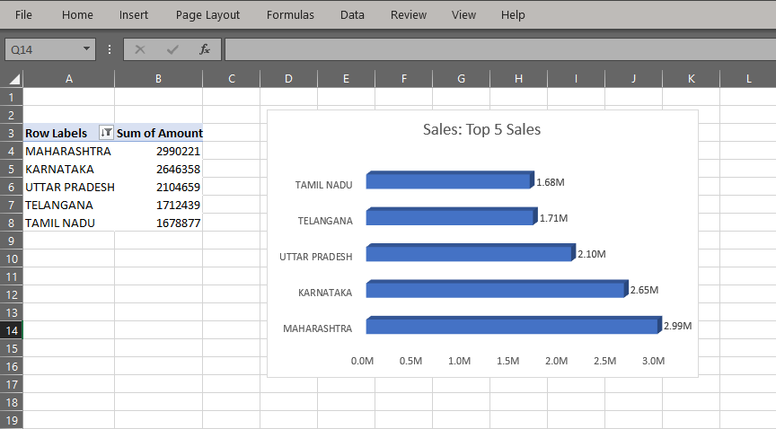
Sales: Top 5 Sales

Slide 9
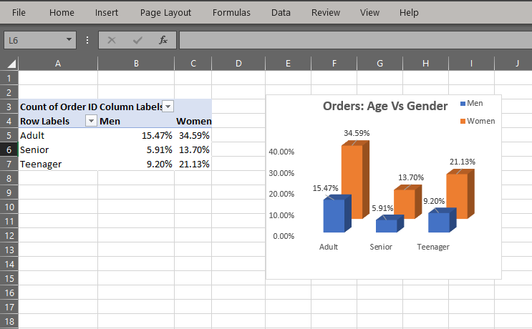
Orders: Age Vs Gender

Slide 10
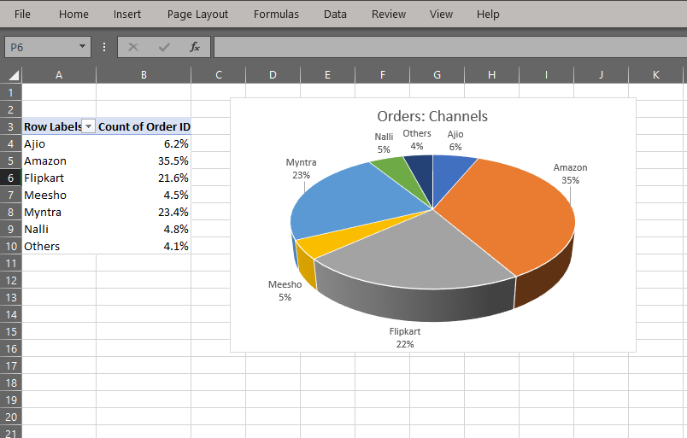
Orders: Channels

Slide 11
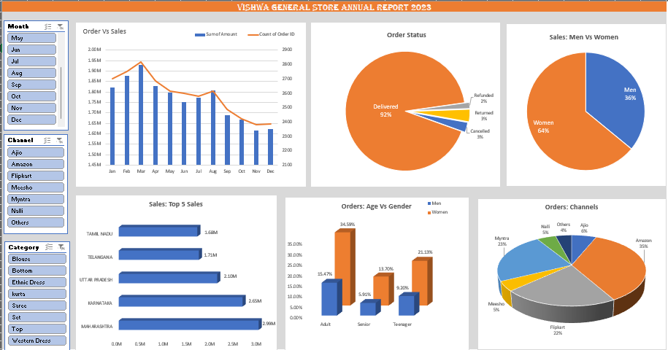
Total Report

Slide 12
Thank You

